Slide 1
YARN and MapReduce

Slide 2
Yarn and MapReduce
Yarn does not know or care what kind of application it is running
Could be MapReduce or something else (e.g. Impala)
MapReduce2 uses Yarn
Hadoop includes a MapReduce ApplicationMaster (MRApplMaster) to manage MapReduce jobs
Each MapReduce job is a new instance of an application
HDFS is unaffected.
Used in MapReduce2 in the same way as MapReduce1.
The programs and commands of MapReduce2 is exactly the same as MapReduce1

Slide 3
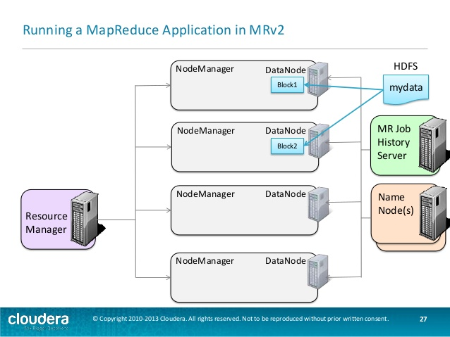

Slide 4
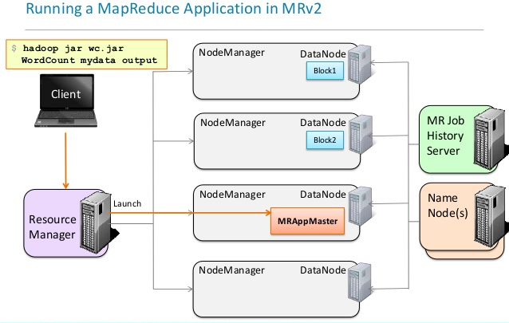
For very small jobs where all the data fits within 1 block, MR2 allows the entire job to be run inside the MRAppMaster
This mode is turned off by default.

Slide 5
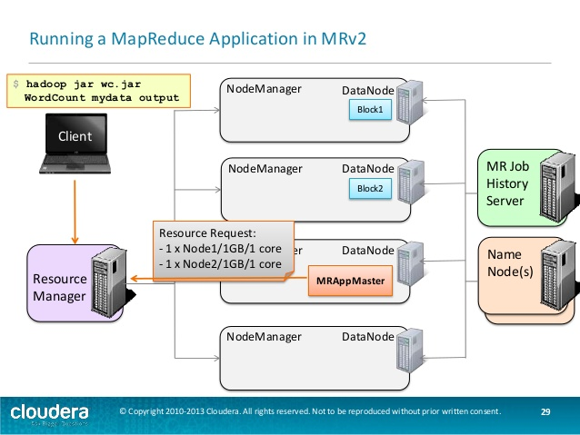

Slide 6
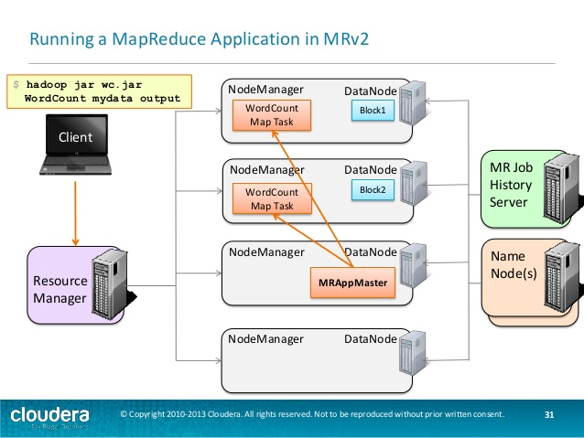

Slide 7
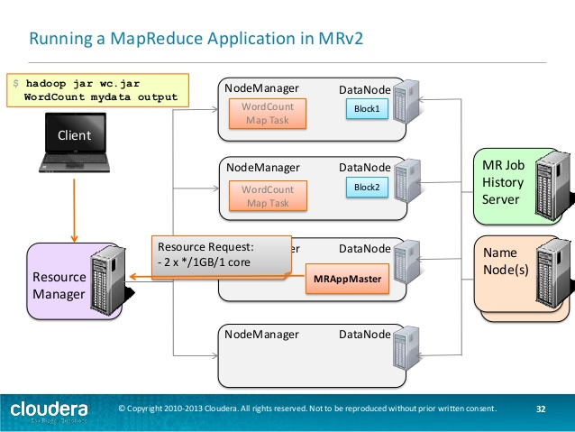

Slide 8
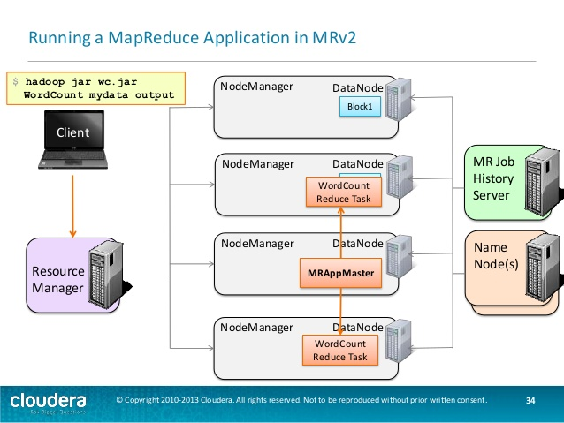

Slide 9
